Slide 1
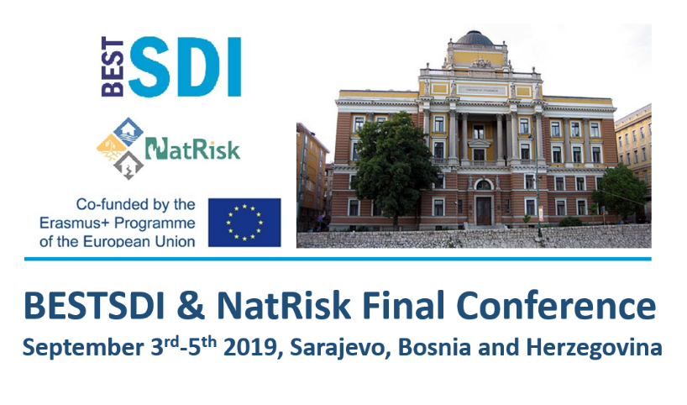
Welcome to Sarajevo The Final conference of BESTSDI and NatRisk ERASMUS+ projects
Development of master curricula for natural disasters risk management in Western Balkan countries - NatRisk

Slide 2
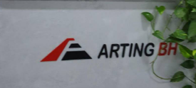
Sponsors
Development of master curricula for natural disasters risk management in Western Balkan countries - NatRisk

Slide 3
Development of master curricula for natural disasters risk management in Western Balkan countries - NatRisk
Venue: Sarajevo
03.09. – BESTSDI - hall „Burence“ in the building of the Faculty of Civil Engineering (untill 16:45)
04.09. – BESTSDI and NatRisk - Ceremonial hall in the building of the University Rectorate (untill 16:45)
05.09. – NatRisk - hall „Burence“ in the building of the Faculty of Civil Engineering

Slide 4
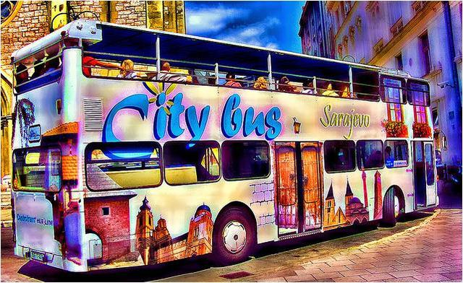
Tomorrow at 17:30 in front of the Rectorate building
Development of master curricula for natural disasters risk management in Western Balkan countries - NatRisk
We will go to tour the city with a tour guide by City bus that takes about 90 minutes.
Sarajevo City bus is a unique tourist bus designed and intended exclusively for sightseeing of Sarajevo city.
The bus offers 90 minutes of listening in Bosnian, English, German or Turkish language guides to familiarize yourself with Sarajevo.

Slide 5
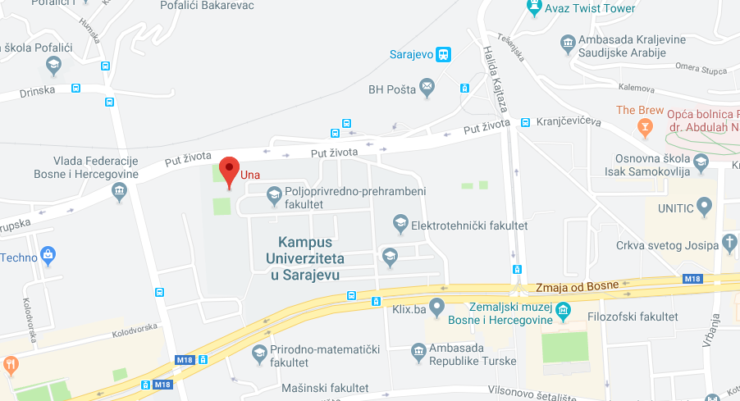
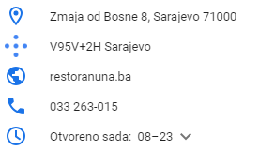
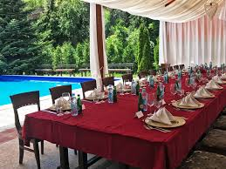
Development of master curricula for natural disasters risk management in Western Balkan countries - NatRisk
https://www.google.com/maps/place/Una/@43.8569169,18.3939016,16z/data=!4m5!3m4!1s0x0:0x7b83cfe258aacf57!8m2!3d43.8575396!4d18.3938909
At 8:00 pm, after sightseeing of Sarajevo city we will go to the restaurant UNA, to the joint dinner.
Restaurant UNA is located in the Campus of Sarajevo University, near the bus and railway station in Sarajevo.
The cost of dinner (with included one drink) is 25 euros.
The total cost amounts
sightseeing + dinner = 30 euros

Slide 6
Thank you for your attention! And Enjoy Sarajevo
Development of master curricula for natural disasters risk management in Western Balkan countries - NatRisk
----
This project has been funded with support from the European Commission. This publication [communication] reflects the views only of the author, and the Commission cannot be held responsible for any use which may be made of the information contained therein.

